Slide 1


Capstone Project
Rahul Raj
rahulraj.crp@gmail.com
EDA on Hotel Booking Analysis by
ALMABETTER

Slide 2

WORKFLOW
Problem Statement
Reading and Data Exploration
Cleaning the Dataset
Exploratory Data Analysis
Data Visualization
Data insights and Conclusion

Slide 3
Problem Statement:
Have you ever wondered when the best time of year to book a hotel room is? Or the optimal length of stay in order to get the best daily rate? What if you wanted to predict whether or not a hotel was likely to receive a disproportionately high number of special requests? This hotel booking dataset can help you explore those questions!
This data set contains booking information for a city hotel and a resort hotel, and includes information such as when the booking was made, length of stay, the number of adults, children, and/or babies, and the number of available parking spaces, among other things. All personally identifying information has been removed from the data.
Explore and analyze the data to discover important factors that govern the bookings.

Slide 4
Reading and Data Exploration
This Dataset has 119390 rows and 32 column
Stays_in_week_nights - stays in week nights
adults – total number of adults in hotel
Children – total number of children in hotel
babies – total number of babies in hotel
Meal – Bed & Breakfast (BB), Half Board (HB), Full Board (FB), Undefined contain no meal package
Country – country of customers
Market segment – A group of people who share one or more common characteristics used for business
distribution_channel –Chain of business through which a service passes until it reaches the final buyer
Previous_cancellations – previous cancellation by customer
Previous_booking_not_canceled- confirmed booked by customer

Slide 5
Reading and Data Exploration
Stays_in_week_nights - stays in week nights
reserved_room_type – Pre-booked by customers
assigned_room_type – single / couple / family
booking_charges – booking charges we charged
deposit_type – No Deposit, Non Refund, Refundable
agent- ID of travel agency
company- ID of the company
days_in_waiting_list – Number of days in waiting
Required_car_parking_space – required car parking space by the customer
Total_of_special_request – number of special request requested
reservation_status - Canceled, Check out
reservation_status_date – Canceled / check out
Is_repeated_guest – contain data of repeated guest
Customer_type – Contract / Group / Transient

Slide 6
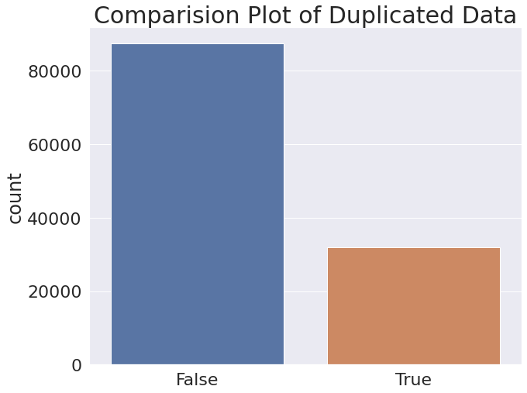
Data Cleaning
So we have 31994 duplicate rows in our data. So we will drop the duplicate rows from our dataset
dropping the duplicate rows
df= df.drop_duplicates()
df.shape #dataset reduced
(87396, 32)
Dropping duplicates since we cannot derive meaningfull insights.

Slide 7
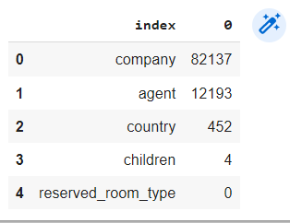
NULL/NaN Value cleaning
Checking the occurence of NULL values
df.isnull().sum().sort_values(ascending=False)[:5].reset_index()
1. DROPPING the column with most missing values
df.drop(['company','agent'],axis=1,inplace=True)
2. For “babies” column replacing Null values with ‘MODE’ since the number is very small 2.For “Country” column Replacing NaN values with 'Others'.

Slide 8
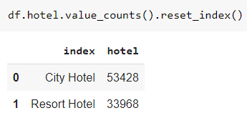
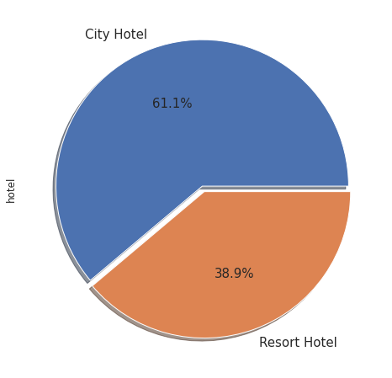
Which Hotel Type is more used
Checking unique values:
df.hotel.unique().tolist()
'Resort Hotel', 'City Hotel'
Visualizing Resort Hotels and City Hotels percentage
City Hotels: 61.1%
Resort Hotels: 38.9%

Slide 9
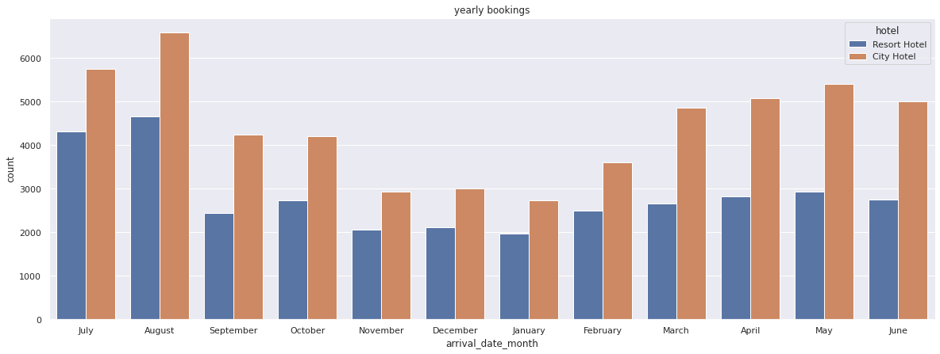
Arrival Date Month Comparing how many Bookings were made for Hotels to Compare
sns.countplot (x= 'arrival_date_month', data= df, hue= 'hotel').set_title ('yearly bookings')

Slide 10
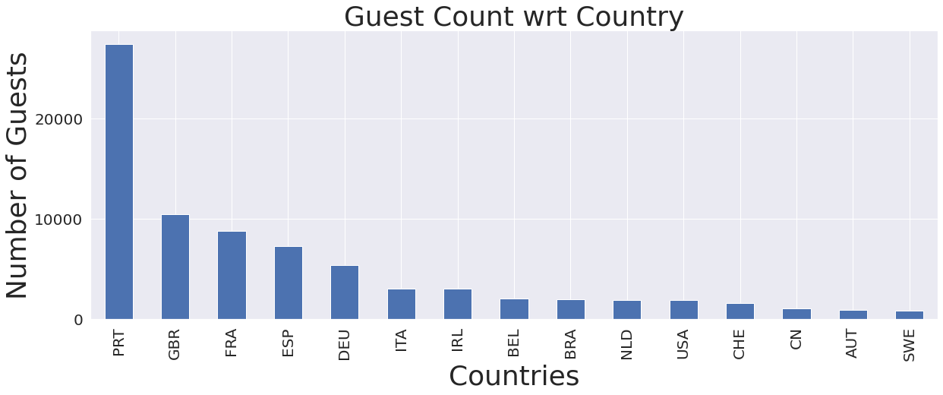
Which Country the Guests are coming from ?
df.country.value_counts()[:15].plot(kind='bar',fontsize=20)
plt.title('Guest Count wrt Country')
plt.xlabel('Countries')
plt.ylabel('Number of Guests')

Slide 11
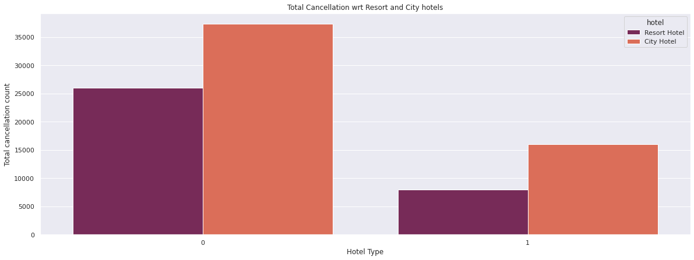
How many cancellations in both types of hotel ?
Plot to see how many cancellations with respect to City Hotel and Resort Hotel
sns.countplot(x='is_canceled', hue='hotel',data=df,palette="rocket")plt.title('Guest Count wrt Country')

Slide 12
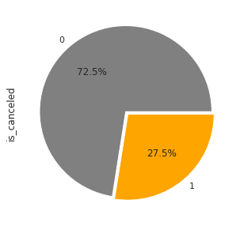
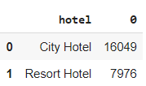
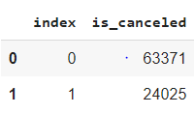
How many cancellations in both types of hotel ?
Plot to see how many cancellations with respect to City Hotel and Resort Hotel
df['is_canceled'].value_counts().plot(kind='pie', explode=(0.02,0.02), autopct='%1.1f%%',colors=col)
1.Total cancellation in the Dataset is 24025 about 27.48%
2.As per the Observations City Hotels has 16049 cancellations
3.As per the Observations Resort Hotels has 7976 cancellations

Slide 13
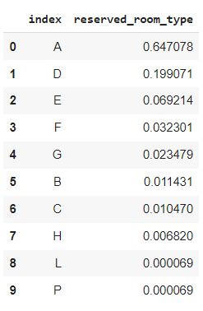
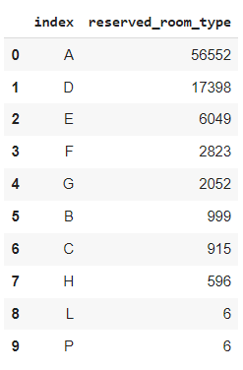
Which Type of Rooms is getting Booked ?
There are a total of 10 Room Types
'C', 'A', 'D', 'E', 'G', 'F', 'H', 'L', 'P', 'B'
1.Most of the Guests Book room type 'A' which is 64.70% with 56552 bookings
2.Second with type 'D' with 17398 bookings and type E with 6049 bookings
3.Room type 'L' and 'P' is booked very few times with only 6 booking

Slide 14
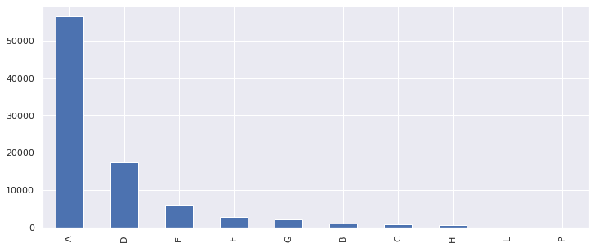
Room bookings visualization

Slide 15
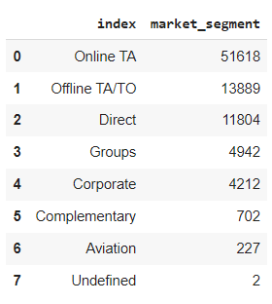
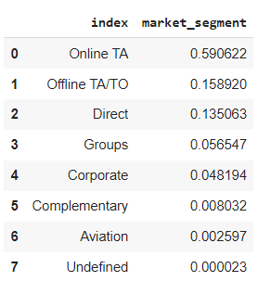
Which market segment the guest was from
There are a total of 8 different Marketting segments
['Direct', 'Corporate', 'Online TA', 'Offline TA/TO', 'Complementary', 'Groups', 'Undefined', 'Aviation']
Observation:
1.Most of the Guests are from 'Online TA' which is 59.06% with 51618 bookings
2.Followed by 'Offline TA' and 'direct' are almost same at 15.89 and 13.5%

Slide 16
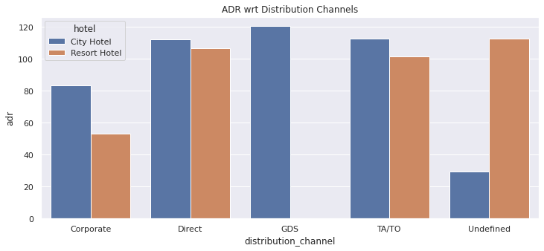
Which distribution channel contributes most to ADR
There are a total of 5 distribution channel
['Direct', 'Corporate', 'TA/TO', 'Undefined', 'GDS']

Slide 17
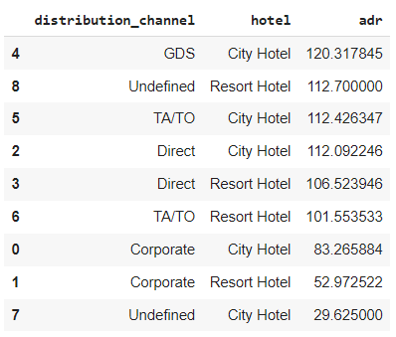
Distribution channel contribution to ADR
df_adr.sort_values(by='adr',ascending=False)
Observation
1.Most of the ADR is contributed by GDS and TA and Direct
2.Most of the Guests are Booking from 'GDS' and in most cases the City hotels gets more bookings
3.Undefined- Bookings are undefined so most probable bookings are on arrival.

Slide 18
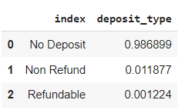
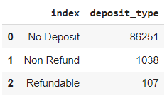
Deposit type for the Booking
There are 3 different Deposit types
'No Deposit', 'Refundable', 'Non Refund'
Observation
1.98.68% of the people don't make a Deposit with 86251 records
2.1.1% of the people make non refundable deposits with 1038 records

Slide 19
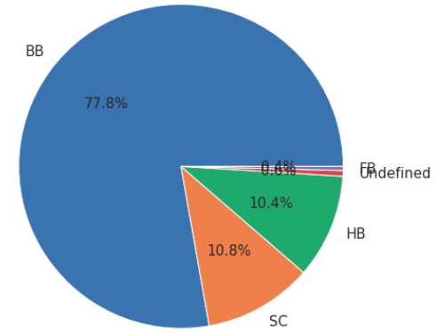
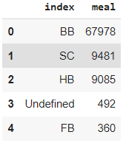
Meal statistics from the hotels
Out of the meals
BB (Bed & Breakfast) is the most ordered meal which is around 77.31%,
HB(Half Board) is 10.84%
SC(no meal package) is 10.39%
Undefined and FB (Full Board) with 0.5%

Slide 20

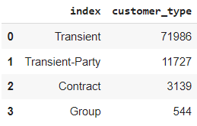
How many Guests are repeated guests
Only 3.19% of the guests are repeated guest
City Hotels has 2032 repeated guests
Resort Hotels has 1778 repeated guests
Observation
75.05% of the guests are Transient guests
Followed with 21.04% of Transient-Party and
3.41% of guests are from Contract
Customer Types

Slide 21
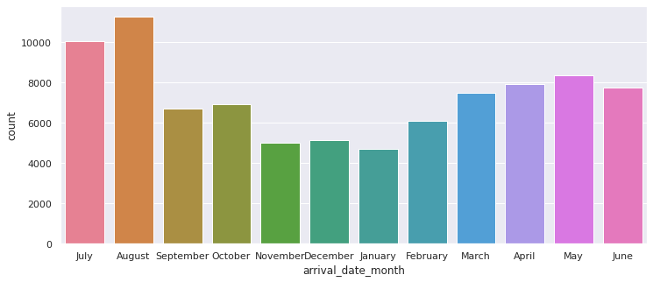
No of travellers in Various Months
August month had most travellers with 12.88% which is 13877 guests July with 11.5% which is 10057 guests,May and October with 8355 and 7908 guests

Slide 22
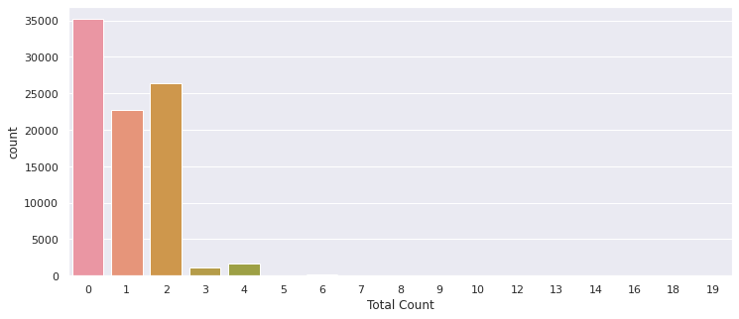
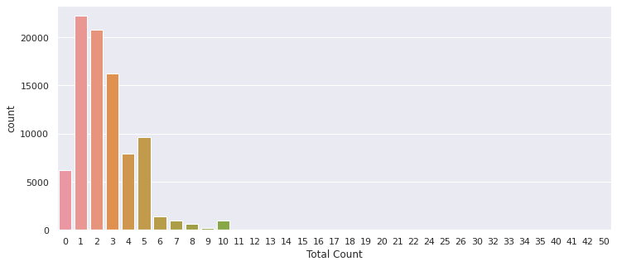
Stay During Weekends and Weekdays
Observation:
Weekends
Most of the time people stayed 2 to 1 days during Weekend
Weekdays
1.52.50% of the travellers were during Weekend
2.Most of the time people stayed 1 day and followed by 2 and 3 days during Week days
Weekend
Week days

Slide 23
Number of people per Room
Observation:
1. 73.79% of the time 2 guests stayed in the room
2. There were 16503 Single rooms bookings made which is 18.88% of total bookings

Slide 24
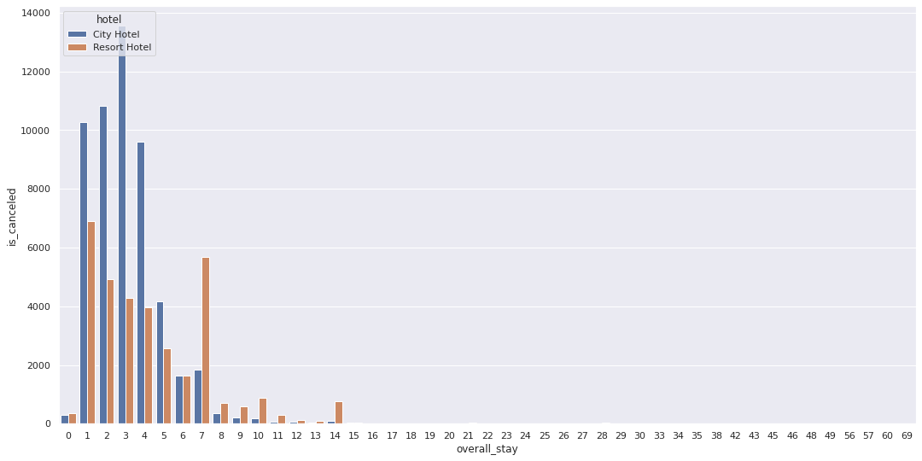
Optimal Stay for Guests
guest_stays = df.groupby(['overall_stay', 'hotel']).agg('count').reset_index()
sns.barplot(x='overall_stay',y='is_canceled',hue='hotel',data=guest_stays)
Observation:
So most of the people stay 1 to 4 days and very rarely they stay above a week

Slide 25
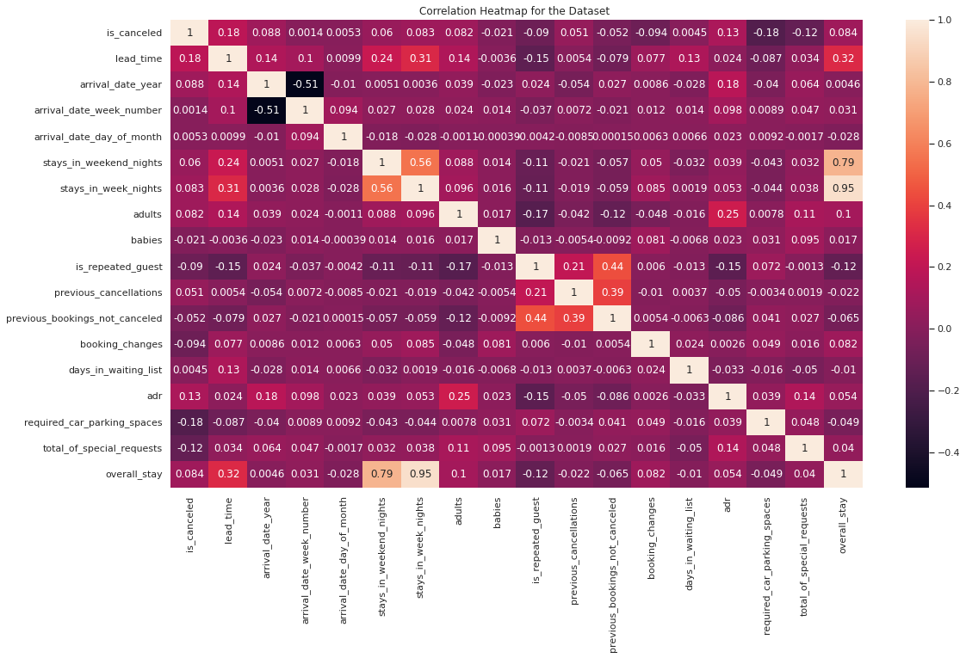
• Previous bookings not canceled" has 44% Correlation with "is repeated guest" which shows that those who has not cancelled their previous booking has more probability to be a Repeated Guest
• adr is slightly correlated with total_people, which makes sense as more guests means more service to deliver, therefore more adr.

Slide 26
Conclusion:
1. City hotels were more preffered by the guests because it is more easily accessible.
2. Portugal country has most guests with 31.41% followed by Britain=11.93 & France=10.11
3. 27.48% of total bookings were cancelled which is 24025 cancellations
4. City hotels have 16049 cancellations which is more then Resort hotels which had 7976
5. Type 'A' room was booked 64.70% with 56552 bookings followed by type 'D' with 17398 bookings and type E with 6049 bookingsRoom type 'L' and 'P' is booked very few times with only 6 booking
6. Most of the Guests are using 'Online TA' which is 59.06% with 51618 bookings Followed by 'Offline TA' and 'direct' are almost same at 15.89% and 13.5%
7. Most of the ADR is contributed by GDS and TA and Direct reservations
8. Set Non-refundable Rates, Collect deposits, and implement more rigid cancellation policies.
8.1 98.68% of the guests did not make a Deposit and very few made Non refundable deposits

Slide 27
Conclusion:
9. 77.31% of the guests order Bed & Breakfastal and around 10% of the guests select Half Board and 10% don't opt for meal packages
10. Only 3.19% of the guests were repeated guests with only 3810 of total guests
10.1. Resort hotels had more repeated guests then City hotels
11. 75.05% of the guests are Transient guests and 21.04% are Transient-Party guests
12. August month had most travellers with 12.88% which is 13877 guests
12.1. July and May has the next most travellers with 10057 and 8355 guests
13. 50.26% of total guests stay in Hotels during Weekend
13.1. Most of the guests stay 2 days or 1 day during Weekend
14. 25.39% of the guests stay only 1 day during Weekdays and 23.73% guests stay for 2 days and 18% stay 3 days during Weekdays, Most of the guests stay 1 day Very negligable percentage of guests stay above 3 days
15. 19% of the bookings made were for Single Rooms
16. Guests who has not cancelled their previous booking has more probability to be a Repeated Guest

Slide 28
Improvement Ideas
1. Resort hotels can increase their business by improving transportation availability for guests
2. Improve marketting in countries which have very low guest counts
3. Mandate deposits to prevent cancellations
4. Improve and advertise the other types of rooms which are not getting booked
5. Try to convert Other rooms to Type A room which is preffered most
6. Give attractive discounts to increase repeated guests
7. Create attractions in other months to improve business
8. Give Discount offers if anyone is staying over 7 days to get a stable income

Slide 29


Thank You

